Slide 1




Identification and Classification of Offensive Tweets
(SemEval19: OffensEval)
Archit Kumar
Arnav Kapoor
Neeraj Barthwal
Shruti Chandra

Slide 2
Problem
Sub-task A: Offensive language identification; [Offensive: OFF, Not Offensive: NOT]
Sub-task B: Automatic categorization of offense type[Targeted: TIN, Untargeted: UNT]
Sub-task C: Offense target identification. [Individual: IND, Group: GRP, Other: OTH]

Slide 3
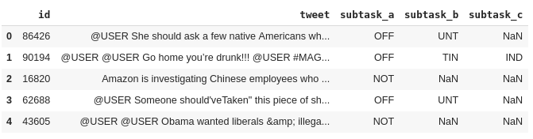
Dataset used
OLID dataset

Slide 4
Data Pre-processing
The first step was to clean and process the tweets so as to remove the noise and other unnecessary words, which is needed for any model and would help in providing better results. The steps used were as follows :-
Decontraction - (can’t -> can not , won’t -> will not )
Stop Words Removal
Case folding
Tokenization and Lemmatization

Slide 5
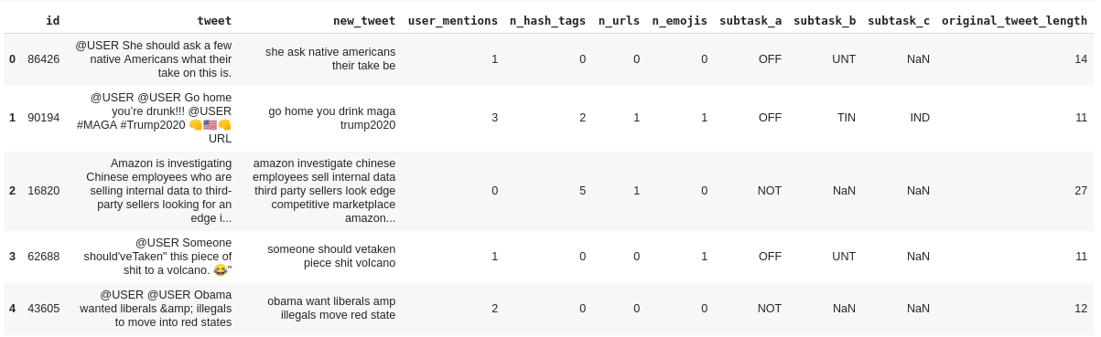
Preprocessed data

Slide 6
Feature Engineering
We added new columns i.e extracting features from the original data to improve the prediction of our models. The features added were as follows :
Number of Hashtags
Number of User Mentions
Length of Tweet
Number of URLs and Emojis.

Slide 7
Word Representations
We need to form a representation of the tweets (that is the mapping from textual data to real valued vectors) before sending it to our model. The various representations used were as follows :
Bag of Words
TF-IDF
GloVe Vectors (300 dimensions)

Slide 8
ML Models
The models used for the classification tasks included the basic machine learning models (LR, Naive Bayes and SVM), and deep learning models (CNN and RNN).
Logistic Regression
Naive Bayes
SVM
CNN
RNN (LSTM and BiLSTM)

Slide 9
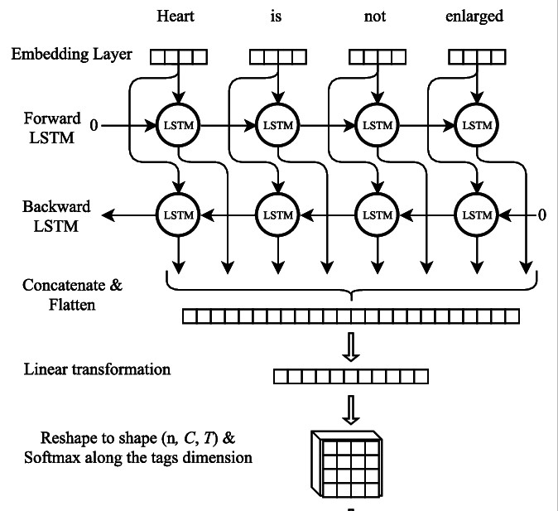
BiLSTM Architecture

Slide 10
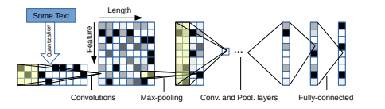
Char CNN Achitecture

Slide 11
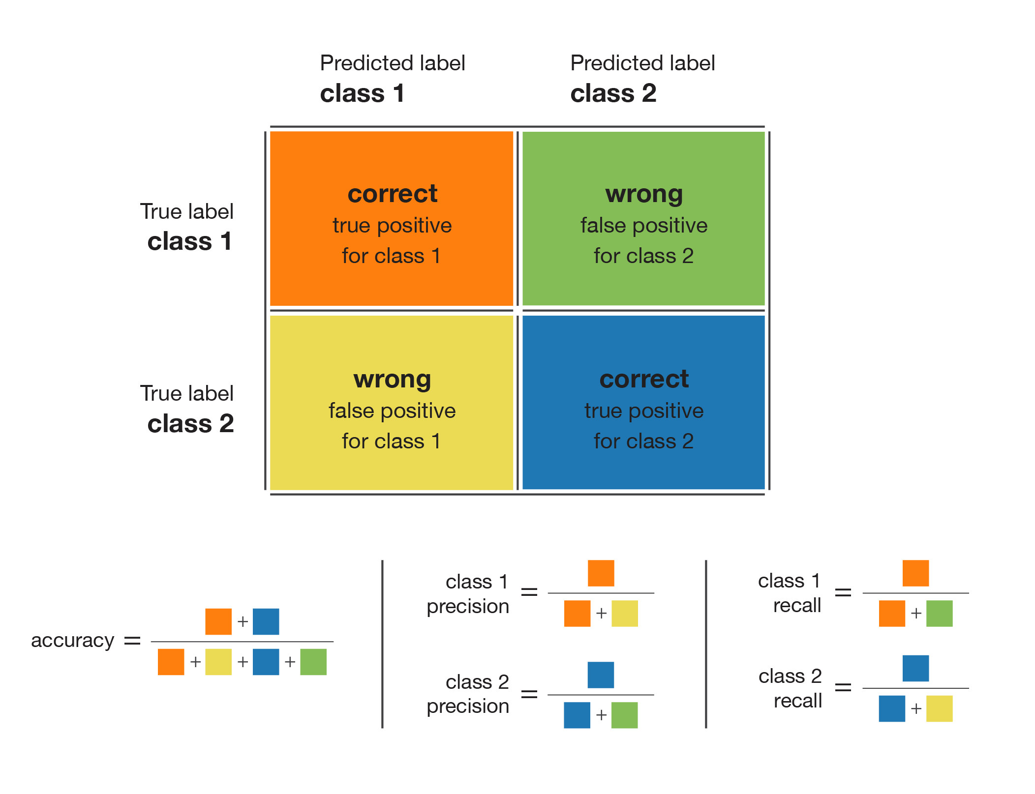
Handling Class Imbalance with weights

Slide 12
Results
Task A
Offensive language identification
F1- Macro Scores
 | Bag of Words | Tf-Idf | Avg Word2Vec
Logistic Regression | 0.712 | 0.710 | 0.649
Naive Bayes | 0.705 | 0.658 | 0.591
SVM | 0.700 | 0.702 | 0.643
CNN | 0.612
RNN | 0.67

Slide 13
Task B
Automatic categorization of offense type
F1- Macro Scores
 | Bag of Words | Tf-Idf | Avg Word2Vec
Logistic Regression | 0.53 | 0.5613 | 0.565
Naive Bayes | 0.542 | 0.597
SVM | 0.56091 | 0.55884 | 0.538198
CNN | 0.49
RNN | 0.534

Slide 14
Task C
Offensive Target Identification
F1- Macro Scores
 | Bag of Words | Tf-Idf | Avg Word2Vec
Logistic Regression | 0.70991522 | 0.72871 | 0.6000737
Naive Bayes | 0.6603611 | 0.6595012 | 0.62080825
SVM | Linear: 0.60705 Rbf: 0.67411 | Linear: 0.63628 Rbf: 0.59587 | Linear : 0.5932 Rbf: 0.5666
CNN | 0.599
RNN (BiLSTM) | 0.621

Slide 15
Thank You!

